Slide 1
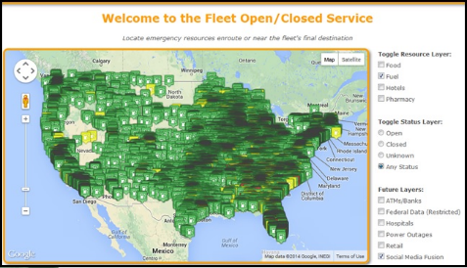
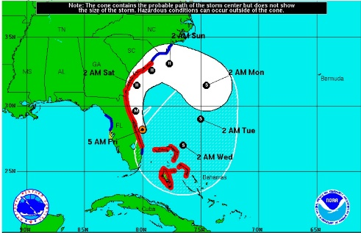
Improving Resiliency w/Better Data
3
M
D
Data Driven Decision Making

Slide 2
Safety Message
Gail Royster
Program Manager

Slide 3
Thank You
D
3
M
Data Driven Decision Making
In Coordination With:
Edison Electric Institute (EEI)
Federation of Earth Science Information Partners (ESIP)
DHS NPPD, Office of Infrastructure Protection (DHS-IP)
NOAA/ National Weather Service
Multi-State Fleet Response Working Group (FRWG)
East Coast Corridor Coalition (EC3)

Slide 4
Today’s Participants
Private Sector
Electric Utility Companies (Duke, BGE, ConEd, PPL)
Telecommunications Companies (Verizon, Sprint)
Trade Associations (EEI, NRECA, APPA, API)
State/Local Agencies
State Emergency Management Agencies (DC, MD & PA)
Research Groups
Federation of Earth Science Information Partners (ESIP)
Federal Agencies:
DHS NPPD - Office of Infrastructure Protection
FEMA HQ and Region III
NASA / JPL
NOAA/National Weather Service (NOAA/NWS)
US Department of Energy (USDOE)
US Department of Transportation (USDOT)
US Geological Survey (USGS)
Higher Education
University of Alabama – Huntsville
Columbia University

Slide 5
Opening Remarks
Chris Eisenbrey
Director, Business Continuity & Operations

Slide 6
Agenda
October 27, 2016
Time | Activity
9:30am | Registration
10:00am | Opening Remarks & Welcome to EEI
10:05am | Session #1 – Why Are We Here?
10:15am | Session #2 - Impact Based Decision Support Services, John Murphy, COO, NOAA/National Weather Service
10:45am | Session #3 - Making Data Matter, Erin Robinson, Executive Director, Federation of Earth Science Information Partners (ESIP).
11:00am | Session #4 - The Private Sector Disaster Challenge
12:00pm | Working Lunch
1:00pm | Session #3 – Report Outs from Lunch Discussions
1:45pm | Wrap Up / Next Steps
2:00pm | Conclusion

Slide 7
Session #1 Why Are We Here?

Slide 8
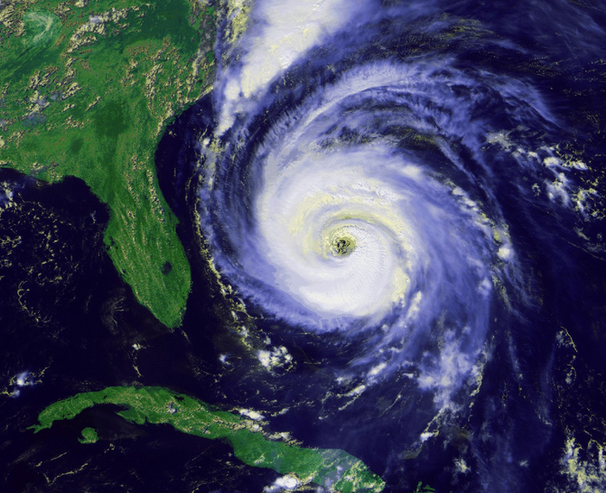
Regional Disasters Expose Coordination Issues
DHS IP
Fuel
Industry Infrastructure Owners & Operators
Energy
Businesses
Treasury
FEMA / USCG
Finance
Food
Federal Government
Justice
Telecom
NOAA
Trans
Electric
Transportation
Public Works
Transportation
Emergency Management
Health
Industry Solution Providers
State & Local Government
Police
Communities
Transportation

Slide 9
Need for Better Data For Decision Makers
Weather Forecasts (Snow, Ice, Tornado, Hurricane)
Security (Looting, Active Shooter, etc..)
Coastal Flooding / Surges
Flooding / Surge / Tidal
Access & Reentry (for repair crews to get into impacted areas)
Fuel Availability
Social Media (disaster incident related)
Food / Water
Weigh Stations Open/Closed
Drone / UAS Data
Lodging Availability
Building Supplies / Retail Stores
Damage Assessment Data (Satellite Imagery, Drone Pics, etc..)
Power Outages & Restoration
Toll Stations Open/Closed
Transportation (Road, Bridge Tunnel Closures)
Critical Infrastructure Locations (Towers, Pipes, Buildings, Underground Assets)
US/Canadian Border Crossing

Slide 10
3DM Initiative Process
Establish Work Group
Leverage SISE Trust Framework & Philosophy
Simple, Operational Benefit, Results
Develop Operational Use Cases
Identify & Integrate Data Sets
Short, Mid and Long-Term Data Sets
Leverage Technology Partners
Test, Validate and Operationalize

Slide 11
Use Case Approach
Universal Use Cases
Cross Sector Use Cases
Electric Sector
Fuel Sector
Food/Water Sector
Telecommunications Sector
Sector Use Cases

Slide 12
Methodology
Government Decisions
Private Sector Decisions
Decision Support Technology Viewers
Sector Use Cases
Data Sets
Federal Agency, Research Data Sources

Slide 13
3Dm Initiative Timeline
Bi-Annual WG Workshops, Monthly Call / Webinars
Oct 2016
Jan 2017
July 2017
Jan 2018
Electric, Food, Telecom, Fuel Sectors
Trans, Finance, Health, Retail Sectors

Slide 14
Session #2 Impact Based Decision Support John Murphy COO, NOAA/National Weather Service

Slide 15
Session #3 Making Data Matter Erin Robinson Executive Director, Federation of Earth Science Information Partners (ESIP)

Slide 16
Session #4 The Private Sector Disaster Challenge

Slide 17
Private Sector Panelists
Panel Speakers
Carlos Torres – Con Edison
Chuck Whitlock – Duke Energy
Kent Kildow – Verizon
John Latka – PSEG
Facilitators
Chris Eisenbrey – EEI
Tom Moran - AHC

Slide 18
Discussion Question #1
“What is your perspective on each government agency’s role and possible data sets they may have available during a regional disaster like recent Hurricane Matthew?”
US Geological Survey
NOAA / National Weather Service
FEMA
NASA
US Department Energy
Dept. of Homeland Security – Infrastructure Protection
US Dept. Transportation
State Emergency Management
State Dept. Transportation
State Law Enforcement / Fusion Centers

Slide 19
Working Lunch
Objectives:
Build “common perspectives and understanding” on organizational roles during regional disasters
Government’s role
Private sector’s role
Develop awareness on possible data sets available in government and private sector
Weather, Fuel, Food, Telecom, Roads, Flooding, Power, etc..
Capture input and recommendations

Slide 20
Lunch Is Served

Slide 21
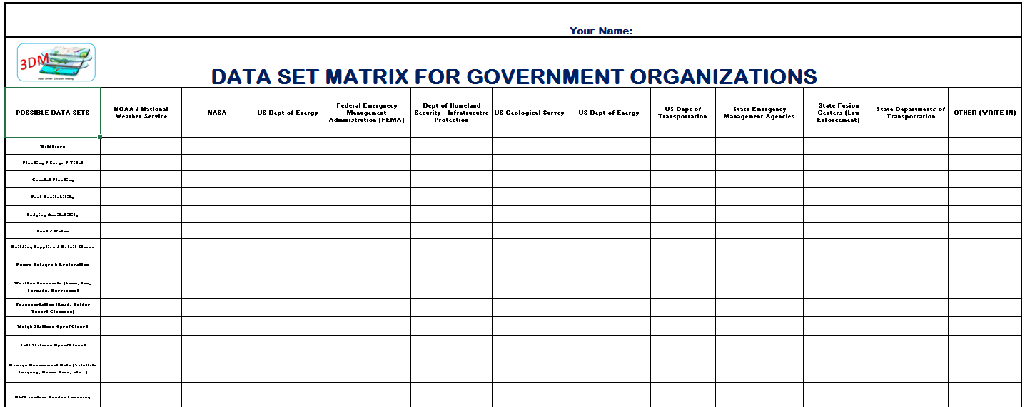
Table Exercise
Objective:
Building awareness of data sources/sets available for operational use by states and private sector
Identify data providers for later follow up
Activity:
Write you name on top of both forms
Place put “X” in boxes on both forms where you know of data that could be used (as best as you can)
Discuss findings as a group
Pick one person to report out to room during 1:00pm session
Table Exercise Tools:
Data Set Matrix(s) on the tables (11x17 paper) are on tables

Slide 22
Table Report Outs
Objective:
Building awareness of data sources/sets available for operational use by states and private sector
Identify data providers for later follow up
Activity:
Pick one person from your table to report out to room of some of your top findings during exercise
Tools:
Data Set Matrix(s)

Slide 23
Session #5 Report Outs from Lunch Discussions

Slide 24
Wrap Up / Next Steps
Objective:
Gain common agreement on the following:
Importance & value of this 3DM initiative
Overall approach & timelines
Organizational participation
Products
Working Group Directory
Communication Website
Data Set URLs Library
Other Ideas?
Next Meetings
Monthly Conference Call / Webinar
ESIP Winter Mtg, Jan 11-13 in Washington, DC
FRWG Annual Meeting, Jan 26-27, Philadelphia, PA
Other Meetings?

Slide 25
Thank You
D
3
M
Data Driven Decision Making
In Coordination With:
Edison Electric Institute (EEI)
Federation of Earth Science Information Partners (ESIP)
DHS NPPD, Office of Infrastructure Protection (DHS-IP)
NOAA/ National Weather Service
Multi-State Fleet Response Working Group (FRWG)
East Coast Corridor Coalition (EC3)

Slide 26
Improving Resiliency w/Better Data
3
M
D
Data Driven Decision Making

